Slide 1

Raspberry-pico controller setup

Slide 2
introduction
Setup controller (slide 3)
Code (slide x 4)
Testing controller windows 10 (slide 5 to slide 6)
Testing controller windows 11 (slide 7)

Slide 3
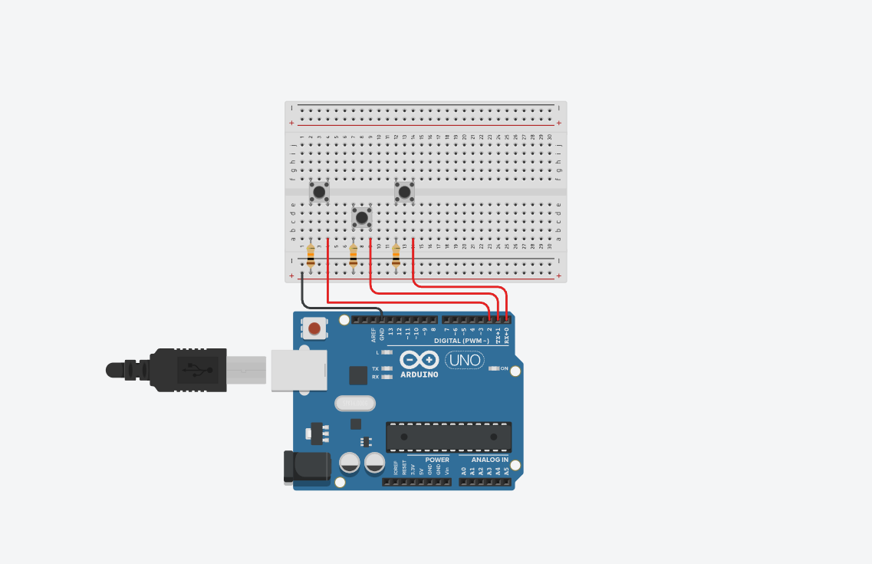
introduction
*note, this is just an example, you can really scale up as much as it allows
Goes 1 to 30 (vertically)
Goes a to j (horizontally)
resistor
Ground cable
Parts needed
- 3 buttons
- 3 10k resistors
- 4 cables
-1 breadboard
- 1 raspberry-pico

Slide 4
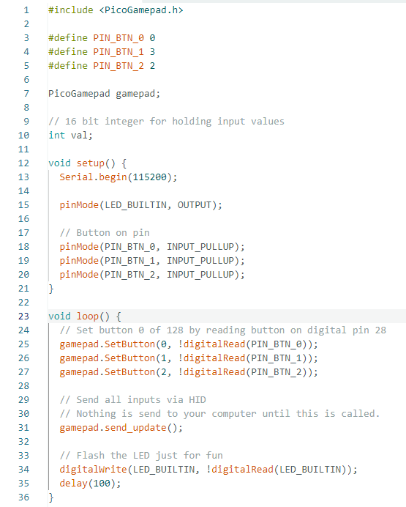


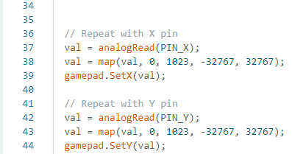
Code
*note, this code only has buttons and no joystick. The code snippets are how you add a joystick.
This is a short setup on how to make the code
Sets the pins you want to use as variables
Defines the pin values
Configures the value types
Reads and sends the value

Slide 5
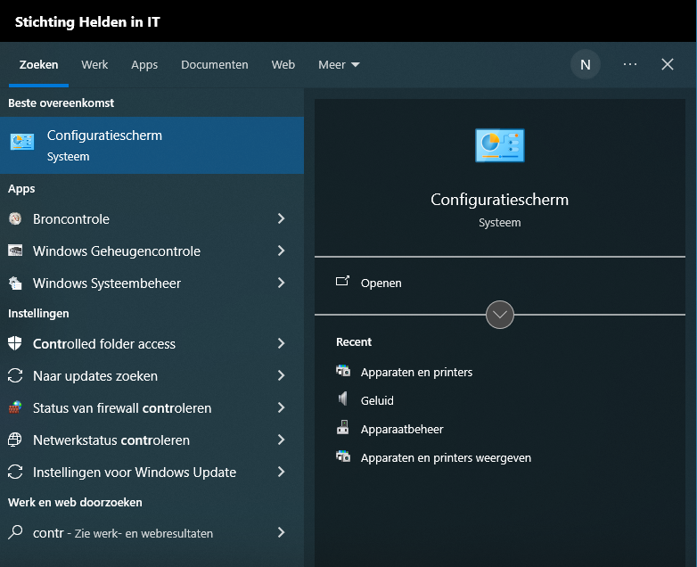
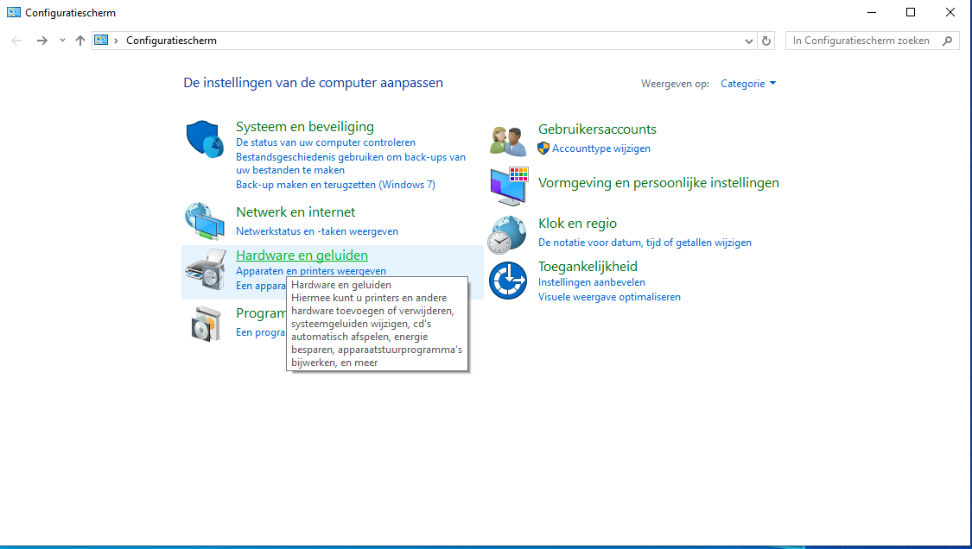
Testing windows 10 step 1
Now that you have your code and hardware set up, it’s time to test whether it works
Start by opening your window’s search bar, find and open control panel
Once you have control panel open, head to ‘Hardware and sounds’

Slide 6
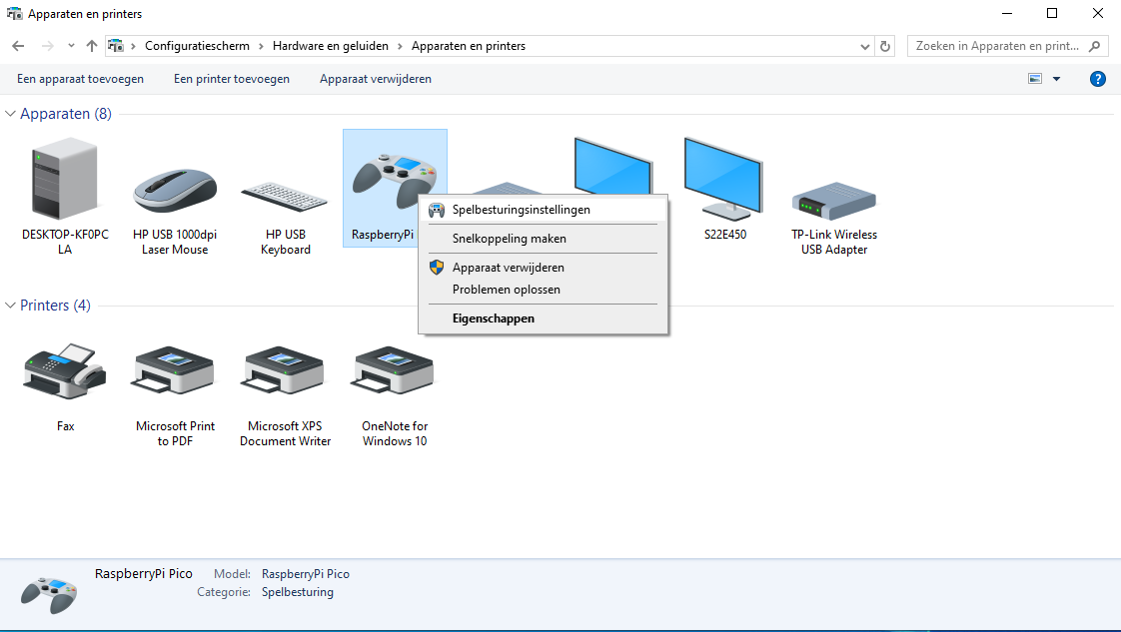
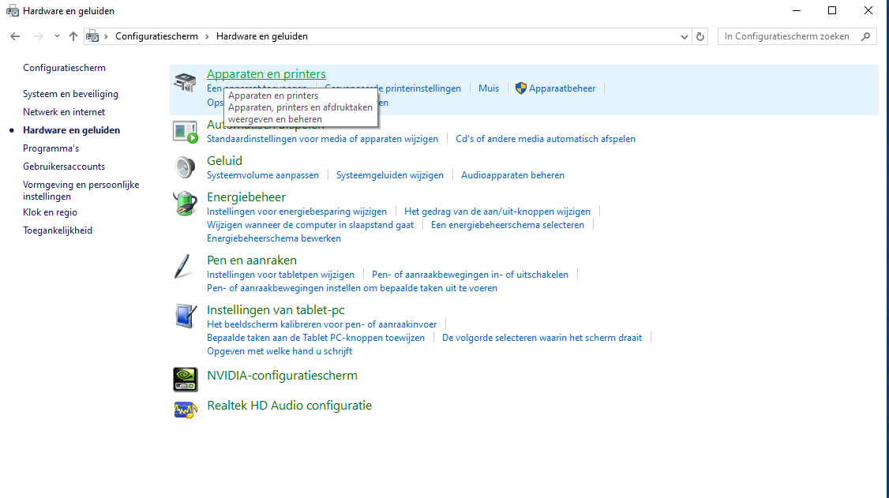
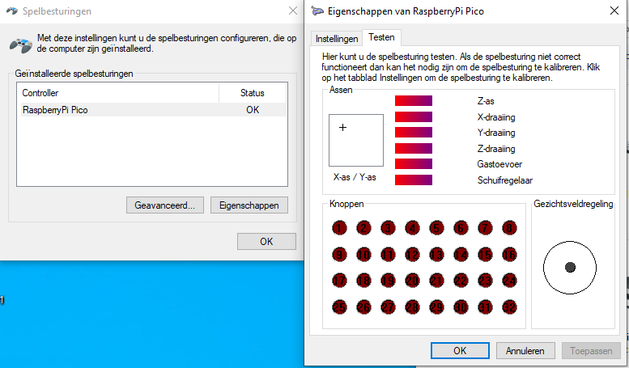
Testing windows 10 step 2
Any of the button pressed will glow if working correctly
This is a short setup on how to make the code
Once you reach this screen, open ‘devices and printers’
Locate your controller, right click it and select the top option ‘game controller options’
Once you have the left menu open, click on properties. This opens the right screen where you’ll select ‘testing in the top’

Slide 7
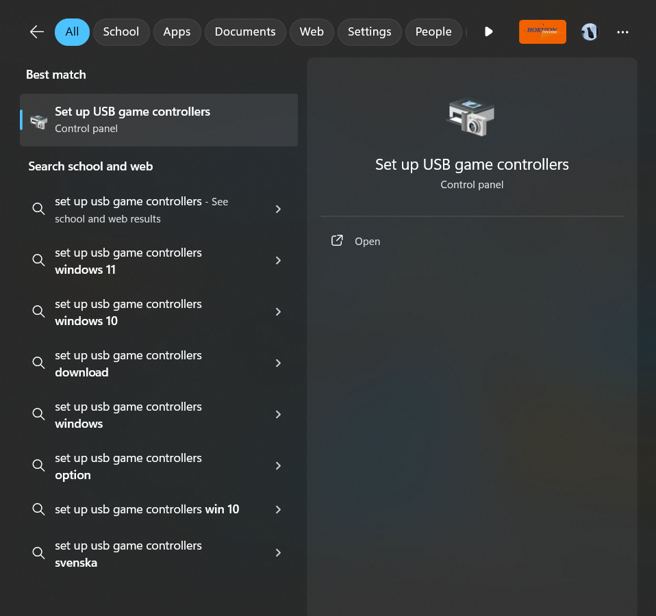
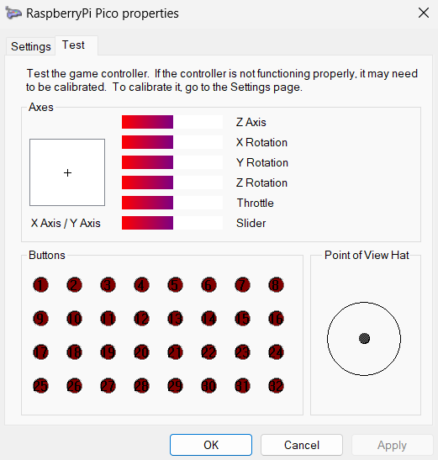
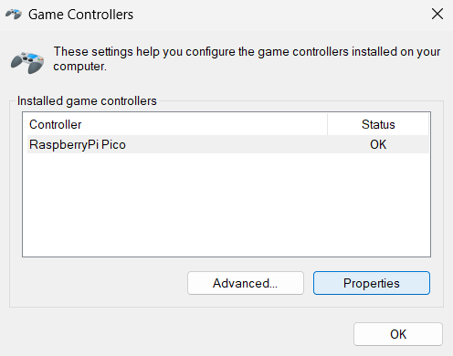
Testing windows 11 step 1
Now that you have your code and hardware set up, it’s time to test whether it works
Start by opening your window’s search bar, find and open ‘set up USB game controller’
When you’re here, you can test your buttons and joysticks to see whether they work by moving (when it’s a joystick) or glowing (when it’s a button)
You will open this menu and select properties

